Slide 1


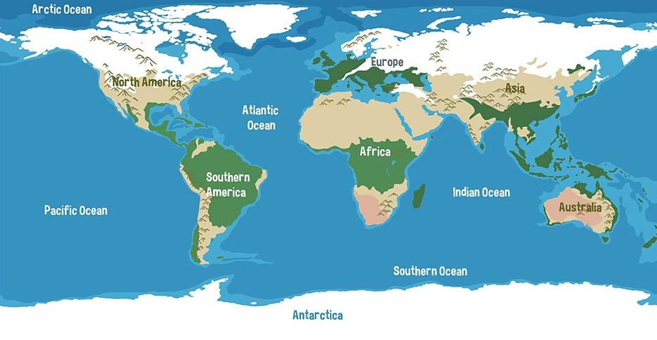

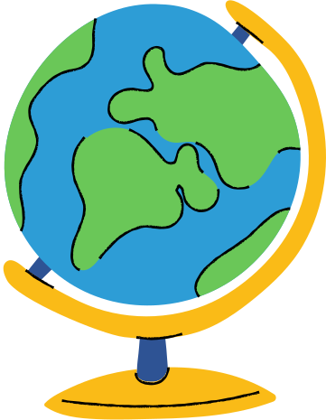
What are the types of water on Earth?
Saltwater makes up the vast majority of Earth’s water (oceans). It cannot be consumed or used for irrigation without desalination.

Slide 2
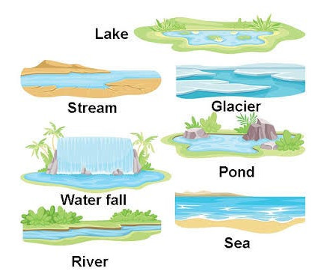
What are the types of water on Earth?
Freshwater is limited, forms only a small fraction of Earth’s total water, and is found in rivers, lakes, wetlands, glaciers, the atmosphere and groundwater. These sources are essential for drinking, agriculture, industry and ecosystems.

Slide 3
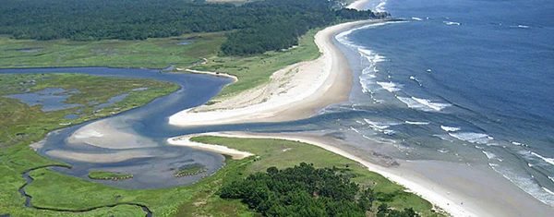
What are the types of water on Earth?
Spaces where freshwater and saltwater mix, such as river mouths, estuaries and some coastal wetlands, are known as brackish water. These areas support unique ecosystems and often act as nursery habitats for marine species.

Slide 4
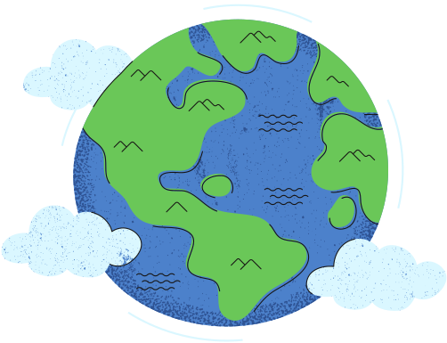

Activity
Graphs are a great way to communicate geographical information. Complete the worksheet, creating a sector graph on the types of water in the world and a column graph, on how much freshwater different continents have.
Notes:
worksheet 1.1

Slide 5
PQE
When analysing maps and graphs, a good structure to follow is PQE:
P | Identify a Pattern | What patterns can you see- e.g. an increase, decrease, high v low income countries….
Q | Quantify your pattern | Give a number to justify your pattern, e.g. the number of countries below a threshold)
E | Identify Exceptions or examples | What exceptions to the pattern exist and why? Or what example really highlights your pattern)

Slide 6
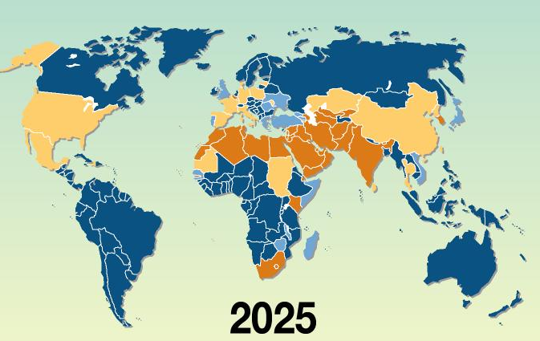
PQE
E.g.:
This map demonstrates the amount of water withdrawn from freshwater resources to use for agriculture and industries.

Slide 7
PQE
Pattern: Countries in low latitudes withdraw the least amount
Quantify: 15 of the 16 countries with the least amount withdrawn can be found in the middle east and southwest Asia.
Exception: South Africa is an exception. Possibly because they have greater access to river systems, withdrawing from neighbouring arid low-latitude countries.

Slide 8
ACTIVITY
The two maps provided demonstrate the distribution of rainfall (precipitation) and amount of freshwater available per person in each country.
Conduct a PQE on the two maps provided, then answer the questions about the distribution and access to water around the world.
Notes:
worksheet 1.2

